Slide 1
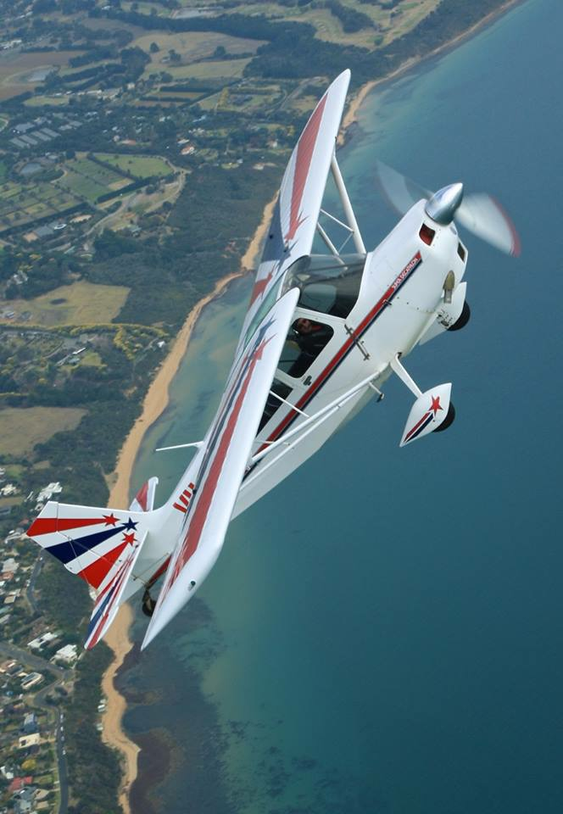
HOW TO WIN
AN AEROBATIC CONTEST
2026
David J Pilkington FRAeS
Notes:
Thanks to Stjepan for the use of his hangar and equipment.
We have refreshments available – no need to rush off afterwards.

Slide 2
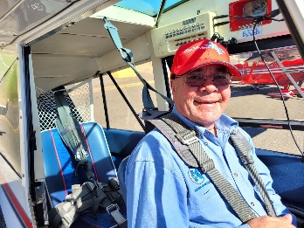
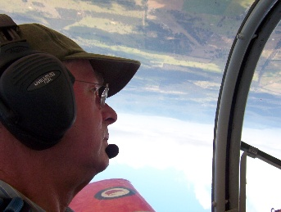
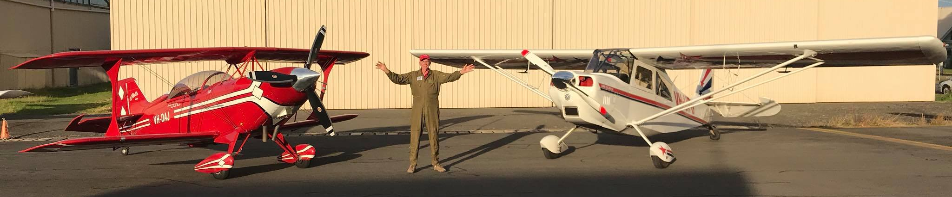

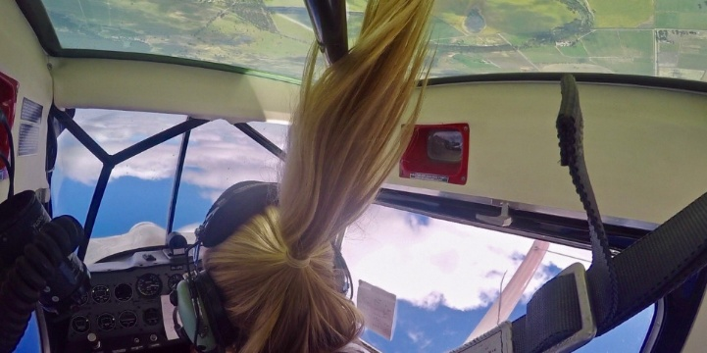
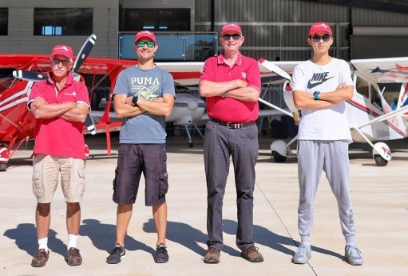
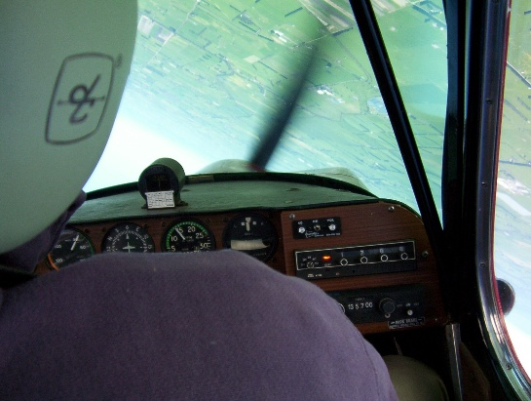
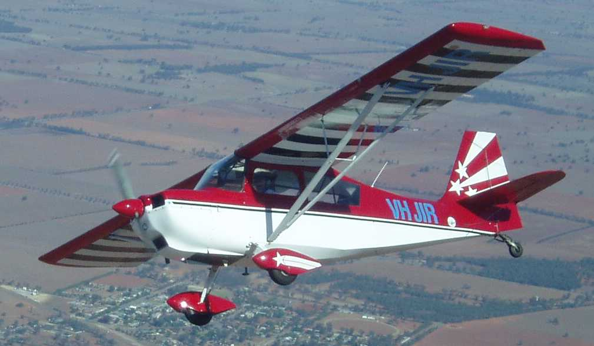
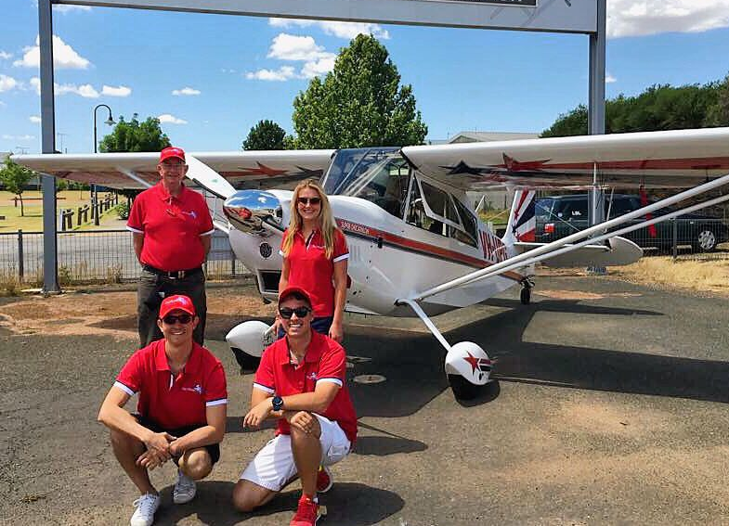
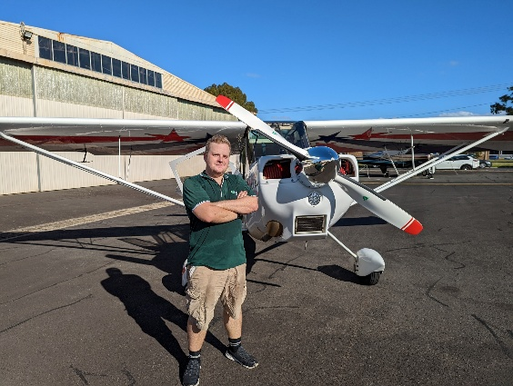
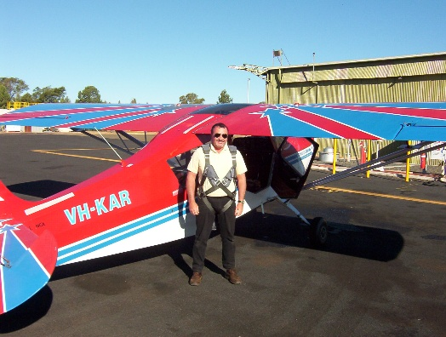
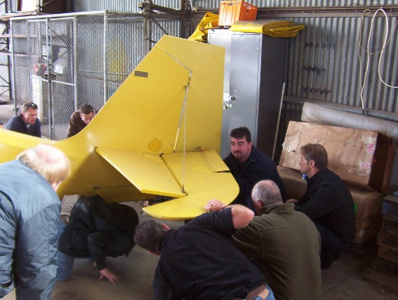
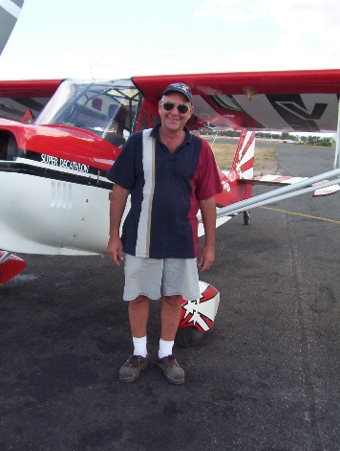
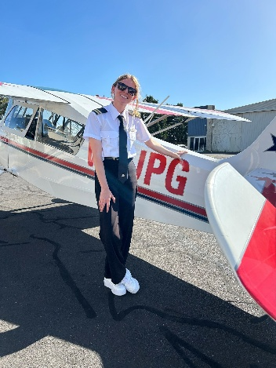
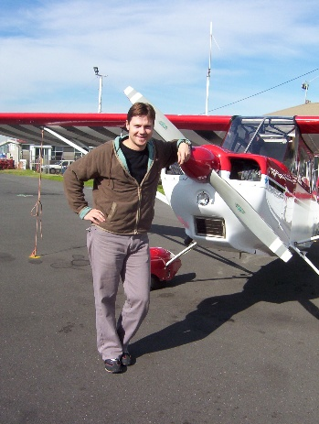
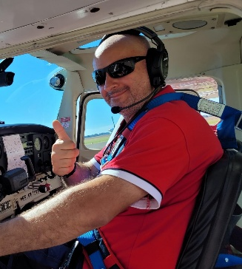
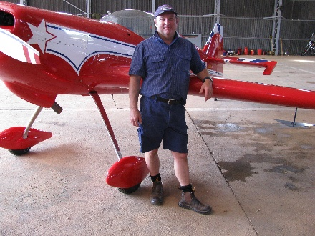
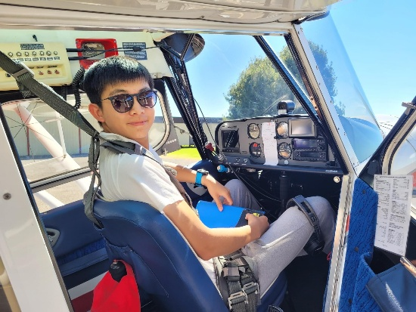
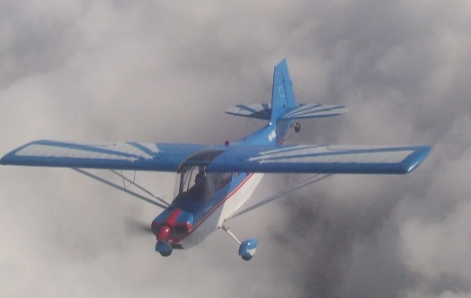
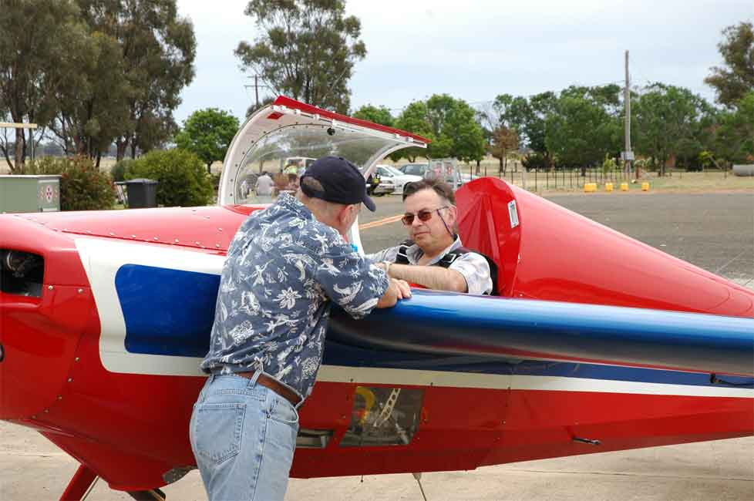
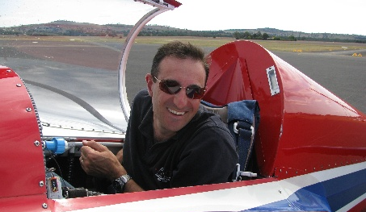
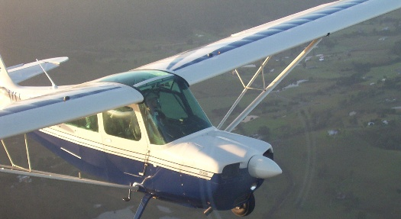
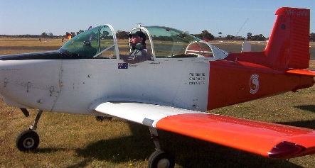
Notes:
B.E. Aeronautical
M.Sc Aero, flight test
USA FAA DER FAR 23 certification
USA FAA approved test pilot
Aviat Aircraft - Vice President Engineering
Boeing Australia - Chief Engineer
Developed RMIT course – flight test engineering
Grade 1 Flight Instructor

Slide 3
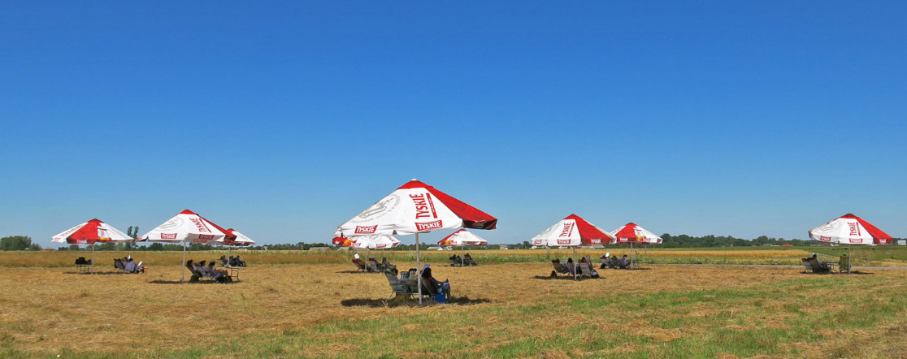
How To Win?

Slide 4
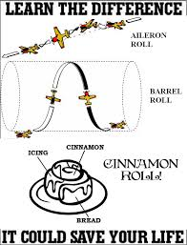
What To Do?
Know what the judges want – the judging criteria for the figures

Slide 5

What To Do?
Know the competition rules to make decisions about:
  Height
  Weather
  Technical issues

Slide 6
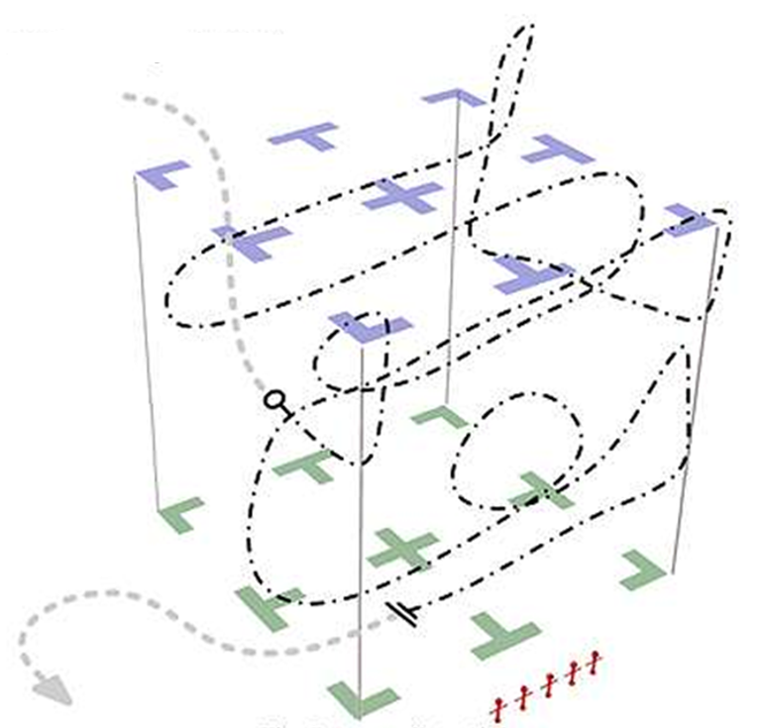
What To Do?
Practice!
  The Known Sequence
  Unknown Sequence Figures
  Your Free Sequence

Slide 7
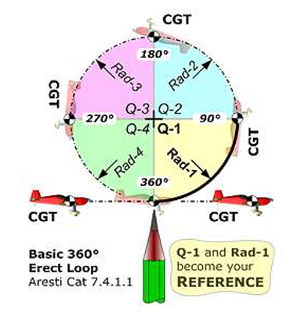
What To Do?
Design the best Free Sequence
  California Freestyle Guidelines
  Suits you and your airplane

Slide 8
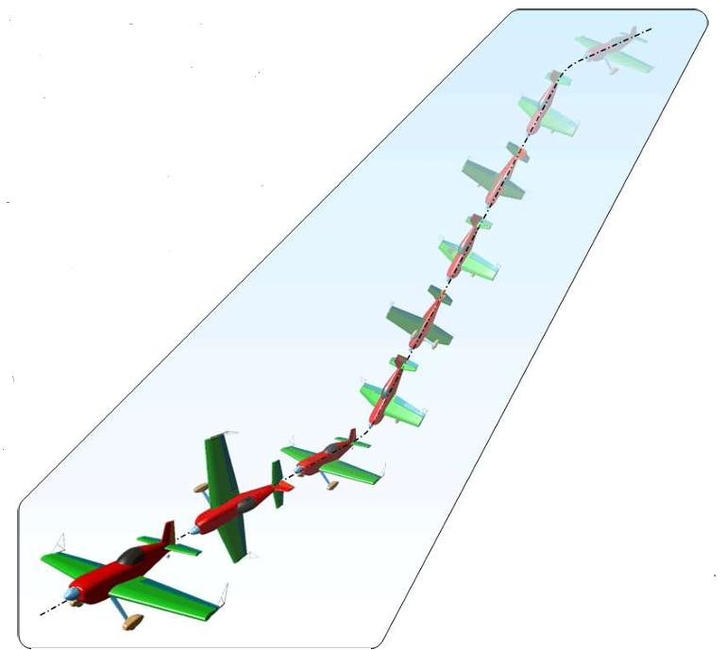
What To Do
Fly The Contest Like The Practice!
  Walk Through It
  Box Entry
  Relax & Enjoy

Slide 9
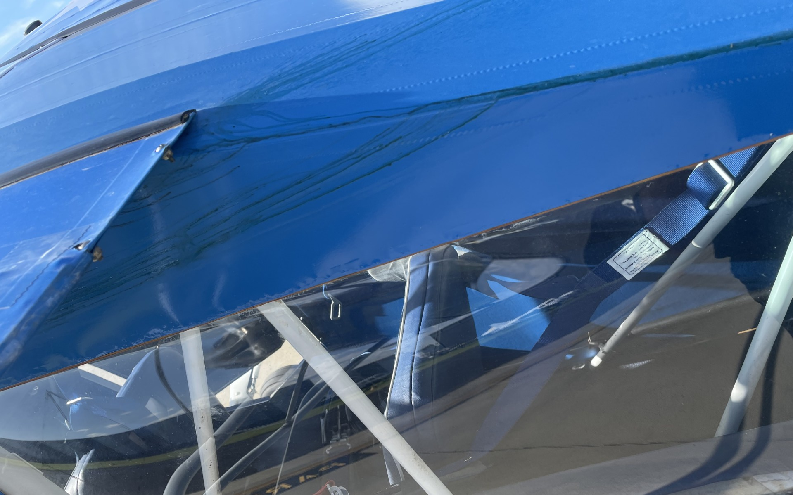
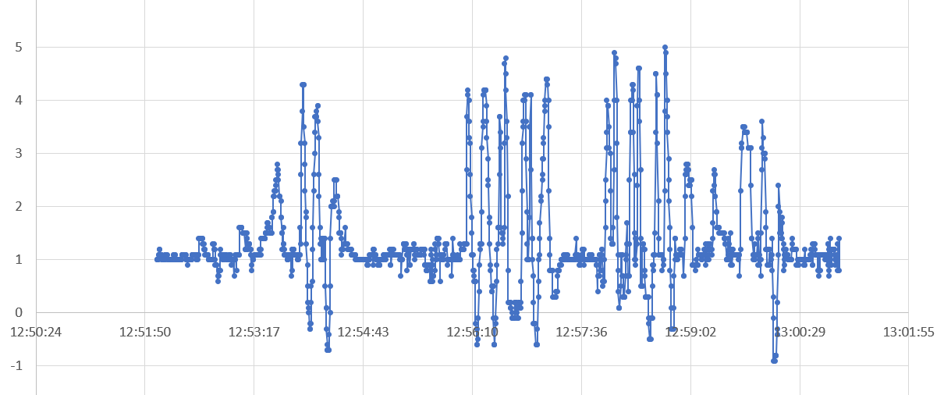
What Not To Do
“VNE means speed not enough”
“anything goes at any speed if you want to win”
Safety check figures then a Sportsman sequence
G
Cracked fuel tank
Time

Slide 10
CONTENT - OVERVIEW
Why competition aerobatics?
Rules and Sequences
Preparation for the Contest
Plan & Prepare Each Flight
FLY TO WIN
What’s What at the Contest
Getting to the Contest?

Slide 11
Why Competition Aerobatics
Flights are short so good for the budget
Easy step after getting an aerobatic endorsement

Slide 12
Why Competition Aerobatics
Fly solo above 3,000 ft or DUAL?
It is a lot of fun, challenging and educational

Slide 13
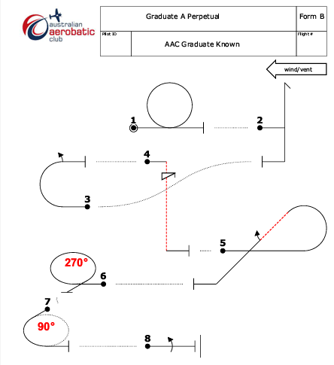
GRADUATE
SEQUENCE
2026
NB: square corners are flown as a normal radius
-
-
-

Slide 14
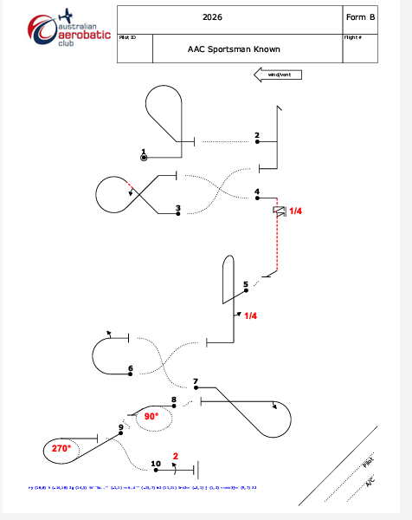
SPORTSMAN
SEQUENCE
2026
This is a challenging sequence, especially #1
#4, #5 & energy into #10
-
Humpty with ¼ roll down
-
NB: the 2024 was more than a challenge in a Super Decathlon – it was a diabolical sequence!
-
DISCUSS DETAILS LATER

Slide 15
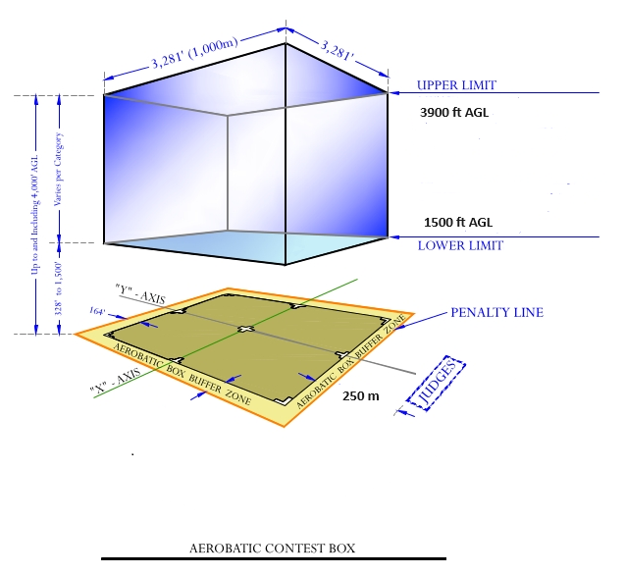
THE AEROBATIC BOX

Slide 16
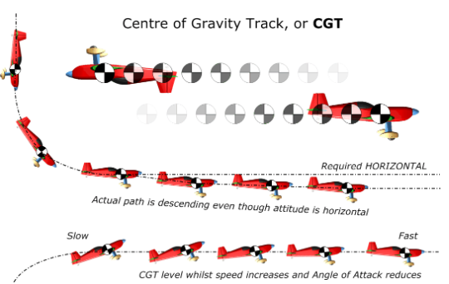
Judging Criteria
Figures must start and end in erect or inverted level flight on the “X" or “Y" axis. Powered aircraft must fly with a perfectly horizontal CGT

Slide 17
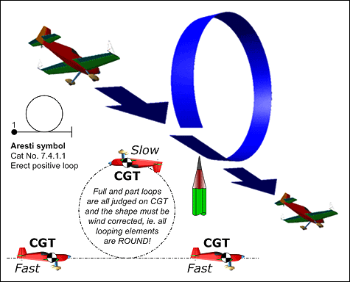
WHAT IS A LOOP?

Slide 18
WHAT IS A LOOP?
SuperD Optimal Loop Entry Speed? (Aerobatic Exploder 29/10/22)
AFM entry speed is 140mph. Usually in contests you are coming out of something else, so 150-160 mph is more realistic. Faster than that is completely unnecessary, as is more than 4G.
Pull to 4G, then continue to tighten gradually as you slow down and go through vertical. When you get to the Key Point, which is 30 degrees past vertical, start easing off. Going over the top you should be at almost neutral stick and floating at about 1/2G. Hard part for me has always been timing the start of the pull in the 3rd quadrant. Let it float and drop on it's own til you are about 45 degrees down, then gradually tighten up to pull through vertical. You should be at 4G when you are at 45 degrees down on the 4th quadrant. Ease off slightly on the last 8th of the loop to keep the pull at 4G and exit at the same speed and altitude you entered at. When you feel a bump as you finish from flying through your own prop wash, you'll know you have it nailed.
TBH most folks get wrapped up around theoretically perfect round loops, but the judges can't see it that well, especially if your positioning is bad. If you are over the near boundary and they are craning their necks to look straight up at you, it's going to be ugly no matter what. OTOH if you initiate when centered up on the judges, at about 2000 AGL and in the far half of the box, it will look pretty good even if not perfect geometrically.

Slide 19
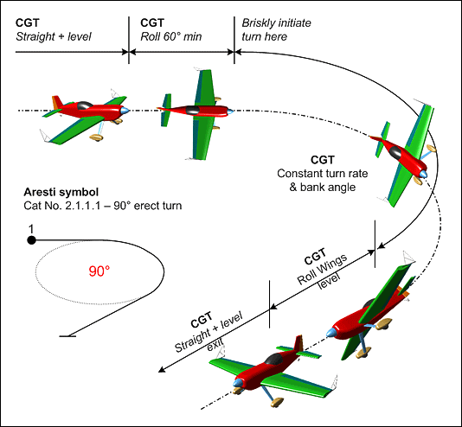
WHAT IS A LOOP?

Slide 20
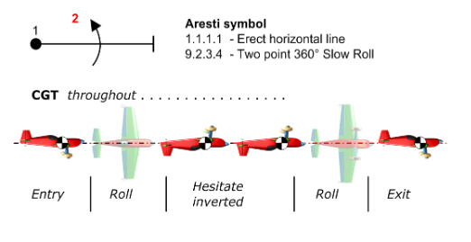

Rolls
Notes:
Prepare your aircraft. You need an LLL (Loudenslager Line Layer), sighting device or
whatever. A very basic one is simply lines drawn on the side window using a white-board
marker. Align them with the Zero Lift Axis.
http://www.aerobatics.org.uk/judging/judging-zla1.htm
The Decathlon has a ZLA of what?
Airfoil section is NACA 1412. Its zero lift angle is about -1 deg.
Wing is set at 1.5 deg on the fuselage.
So, the Zero Lift Axis is -2.5 deg, let’s say -2 or 3 deg nose-down compared
to the fuselage reference line.
Hopefully the judges also knowthat!

Slide 21
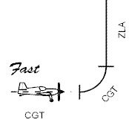




Vertical
Lines
Notes:
Straight and level whether upright or inverted is judged on flight path. i.e. climbing or descending is penalised. As is any deviation in yaw or unwanted bank angle.
At low speed the nose high attitude from the required angle of attack will be expected. Some will have a much higher nose attitude when inverted.
Vertical climb is based on aircraft attitude for zero lift. i.e. in nil wind the aircraft will go vertically up or down. Markers on the struts or side window used as a sight to get the right angle. Critiquing from the ground will help a lot.

Slide 22
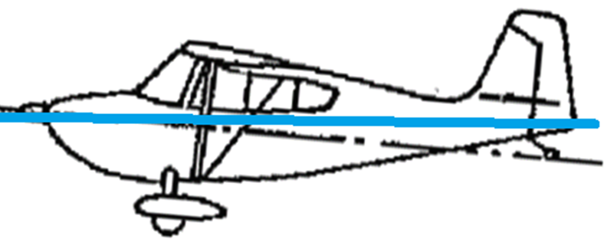
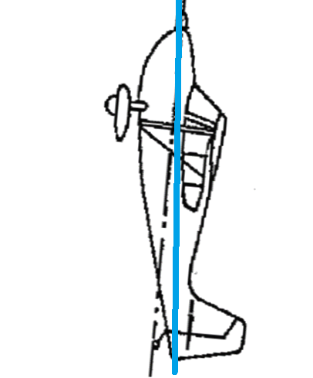
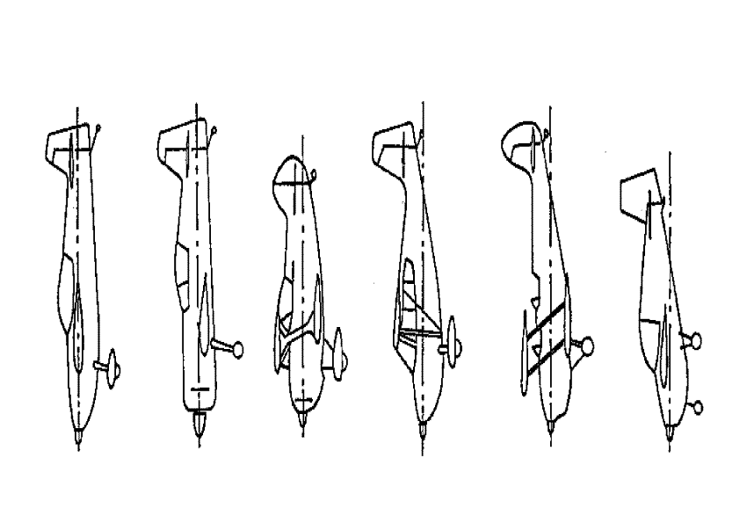
Zero Lift Axis
Notes:
Prepare your aircraft. You need an LLL (Loudenslager Line Layer), sighting device or
whatever. A very basic one is simply lines drawn on the side window using a white-board
marker. Align them with the Zero Lift Axis.
http://www.aerobatics.org.uk/judging/judging-zla1.htm
The Decathlon has a ZLA of what?
Airfoil section is NACA 1412. Its zero lift angle is about -1 deg.
Wing is set at 1.5 deg on the fuselage.
So, the Zero Lift Axis is -2.5 deg, let’s say -2 or 3 deg nose-down compared
to the fuselage reference line.
Hopefully the judges also knowthat!

Slide 23
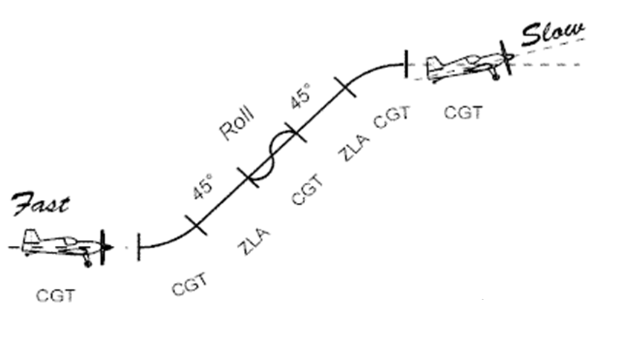
45^{O} Lines
Notes:
A 45 deg climb has several elements with different ways of alignment:
- initially level - on track or flight path
- pull-up – on flight path – a radius
- straight climb on attitude
- if there is a roll -on flight path
- push over – on flight path – a radius again
- straight and level again – low speed so higher attitude

Slide 24
Marking the figures - the basic rules
Start with a perfect 10 – deduct errors seen to nearest ½ point
Every 5^{O} off is 1 point
Score is multiplied by the K factor (difficulty)
  eg Loop K = 10 so 100 points
  Hammerhead K = 17

Slide 25
Marking the figures - the basic rules
Zero for:
  Exceeding 90^{O} off line
  Wrong way on x axis
  Wrong figure

Slide 26
General – IMPORTANT RULES
No Official Practice flights will normally be allowed once the contest has commenced
A competitor must signal the start and finish of each sequence, and any interruption, by distinctly dipping the wing three (3) times immediately one after the other by more than 45°. For the sake of clarity, “immediately” is defined as within 3 seconds of the previous wing dip.

Slide 27
General – IMPORTANT RULES
For all Sportsman, Graduate and Entry programmes the time limit will be 10 minutes. For timing purposes the program is deemed to start on the return of the wings to level after the wing rock; and is deemed to finish on their return to level after the third of the final wing rocks
A competitor will be given penalty points if he or she interrupts his or her program. Interruptions will be signalled by the competitor by dipping the wing three (3) times immediately one after the other.

Slide 28
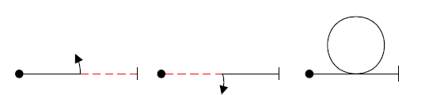
General – IMPORTANT RULES
Before signalling (wing rocks) the start of a competition flight in all programmes, it is recommended that pilots perform the following safety figures.
optional but, if flown, may only be flown once, in any order, and continuously on the same axis. They must be flown inside the performance zone.
Practice:
Box entry
Loop
Two point roll

Slide 29
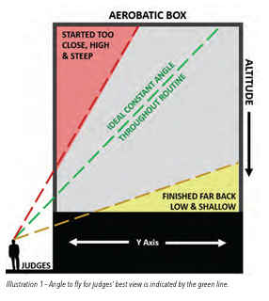
General – IMPORTANT RULES
Low altitude – stay well away from the limit!
Don’t fly behind the judges!
PRESENTATION TO THE
JUDGES IS IMPORTANT
If you can see the judges they
can see you and vice versa.
Judges want to clearly see the
shape of each figure so
ONLY FLY IN THE HALF OF THE BOX AWAY FROM THE JUDGES

Slide 30
SPORTSMAN
SEQUENCE
2026
#4 technique to finish
#5 risks exceeding Va limits and over-G
#6 pinched top due wind
-
-
#10 required entry speed and how to get it?
Positioning plan!
-

Slide 31
Graduate – IMPORTANT RULES
Fly the Known sequence three times
Competitors in Entry and Graduate category will receive automatic approval to compete with a 3000’ aerobatic endorsement, rather than the required 1500’ aerobatic endorsement.
A Safety Pilot may be used by those pilots lacking a 1500ft Aerobatic Endorsement in Graduate category otherwise they must fly the sequence not below 3000ft AGL.

Slide 32
Graduate – IMPORTANT RULES
Upper limit 3,900 ft; lower limit 1,500 ft
  High altitude infringement – NIL
  Low altitude infringement – 100 points up to 200 ft lower then zero!
Programme Interruption – 10 points - cheap

Slide 33
Sportsman – IMPORTANT RULES
Fly three sequences:
  Known
  Free (or repeat Known)
    12 figures max; same max K as the Known
    more practice time but can earn an extra 10% points
  Unknown – so practice typical figures
A Safety Pilot may be used by those pilots lacking a 1500ft Aerobatic Endorsement otherwise they must fly the sequence not below 3000ft AGL
  The competitor shall apply in writing to the Contest Jury before the use of a safety pilot shall be approved.

Slide 34
CALIFORNIA FREESTYLE GUIDELINES
A good Free Sequence can score 10% better than repeating the Known!
Assume a headwind and a crosswind
Put spin entry into wind
Loop entry into wind
Nothing centre-box going downwind
Minimise point rolls
Avoid full loop
Avoid multiple 45 deg lines
Have a xwind corrector
Avoid spins with ¼ & ¾
Get the maximum K
Use maximum number of figures
Make every figure easy
Every figure should score well

Slide 35
Sportsman – IMPORTANT RULES
Sportsman Pilots flying with a safety pilot at an Australian Aerobatic Championship will be classified as “Hors Concourse“ - not ranked or eligible for any awards or medals.
Upper limit 3,900 ft; lower limit 1,500 ft
  High altitude infringement – 10 points
  Low altitude infringement – 100 points up to 200 ft lower then zero!
  A Super Decathlon is a lot bigger than a Pitts S-1 so stay above 1800 ft!
Programme Interruption – 20 points – compare with a loop -100 points maximum

Slide 36
Present to the Judges
Forget the box, fly for the judges
Judging positions will change
Wind variations
Mark card – S or O
  Same or Opposite
  Plan which way to turn but …..
Decide where to start the sequence

Slide 37
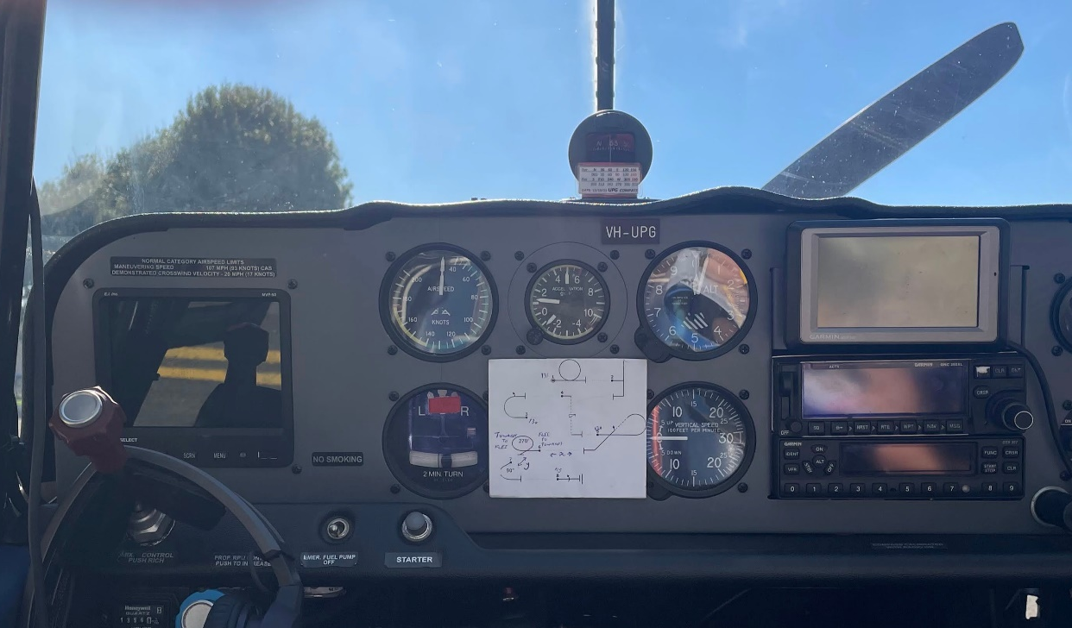
Actions
Prior to Flight
Walk through the sequence
  Until you are sick of it
Sit in the airplane:
  Talk through the sequence
  Where to look
Sequence card marked up
Blu Tack

Slide 38
ENTERING THE BOX
Approach from the holding area unless flying the box lower boundaries
Fly the safety check manoeuvres in the box – use as practice
Where to start #1, what height and speed?
So: what height and speed to commence box entry?
Long straight-in approaches are easy to misjudge!
Stay close to the box
Fly a “base leg”
Wing dips
Level - start

Slide 39
Flying an Aerobatic Sequence
Before each and every figure check the gate:
  Altitude
  Airspeed
  Are you in the right place going in the right direction – where are the judges – where should they be?
Think of the next figures
You don’t have time to think how to fly the figures so
  Muscle memory

Slide 40
Fly for the judges
Fly it like the practice
Take a break – it is cheap!
After aeros – forget and focus on rejoining circuit and landing
FLY TO WIN

Slide 41
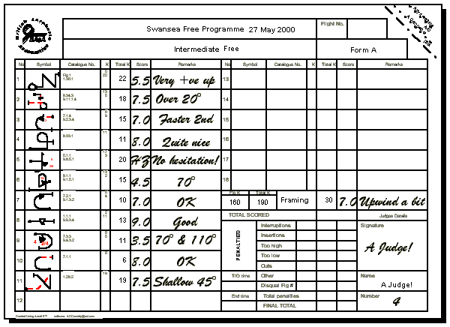


Notes:
When you get your score sheets see what the judges have written as a guide for you to fix next time

Slide 42
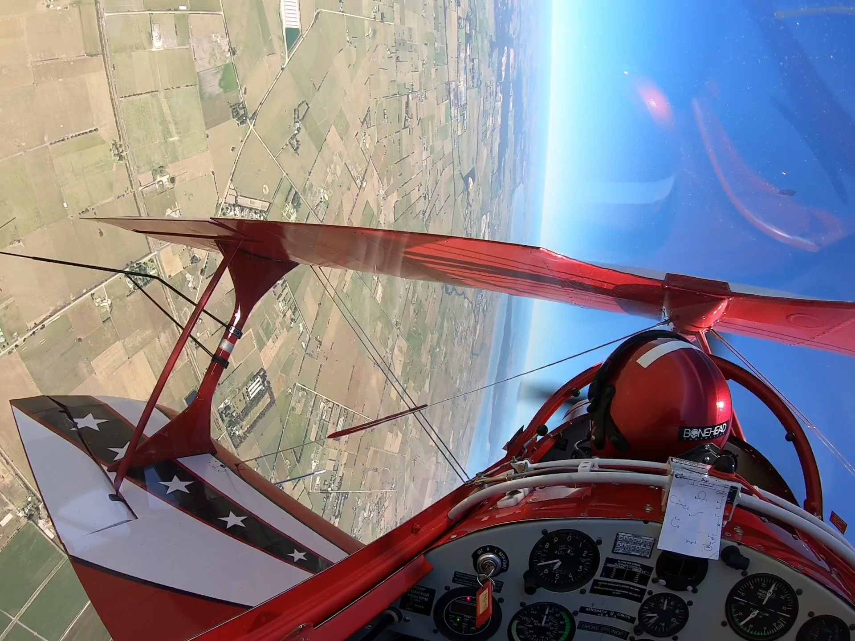
COACHING
From the ground
  Radio perhaps
  Audio recording
In the aircraft – flight instruction
Video
  Mounting?
  What view?

Slide 43
What’s What at the Contest?
Registration – upload documents prior
Practice/coaching in days prior
Local landmarks and “the box”
  Runways
  Town and river
Daily Briefing
  for your safety
  including practice days
Jobs – penciller …

Slide 44
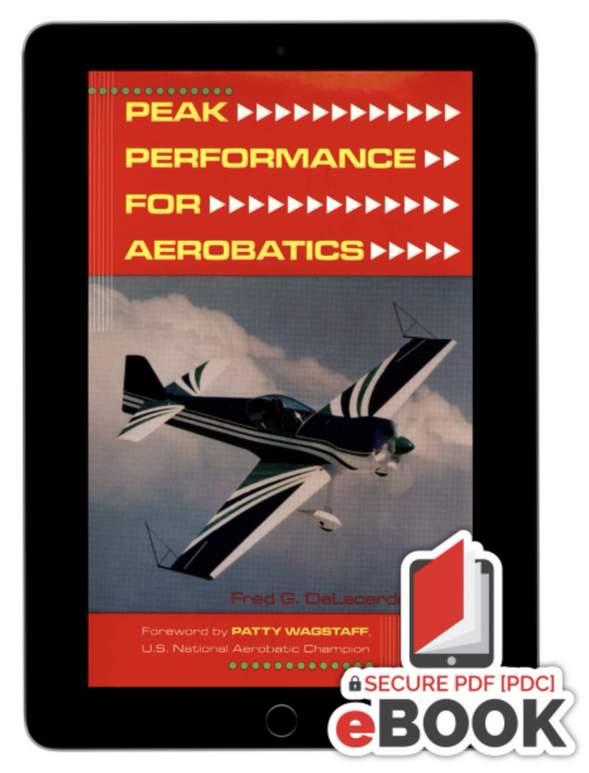
Winning Tips

Slide 45
Video of Sportsman Category Flights 2025
Note the risks with Unknown Sequences – can you identify the risks in the sequence here?
https://youtu.be/d3cuWHTP2pg?si=8laX2ElB8M4UF_MS

